Slide 1
Bike Share Case Study: “Cyclistic”
Goal: Maximise the number of annual memberships

Slide 2
Questions about the data set:
How do annual members and casual riders use Cyclistic bikes differently?
Why would casual riders buy Cyclistic annual memberships?
How can Cyclistic use digital media to influence casual riders to become members?
What changes are the key stakeholders able to make?
Development of campaigns and initiatives
This will be important and guide the direction of our conclusions

Slide 3
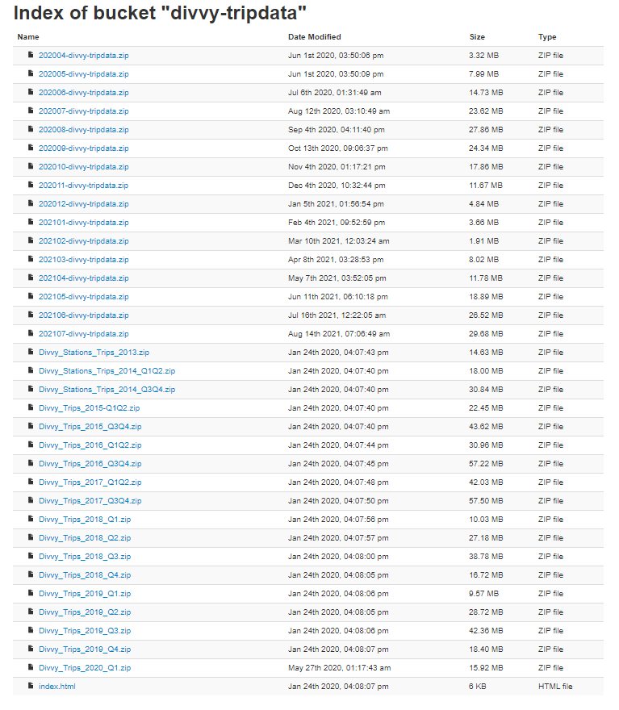
Preparing to use data
The data is organised as shown.
I will need to:
Identify any issues with bias and credibility _{(none found)}
Identify how it helps us solve the problem (It contains data for start and end time, and of course whether or not a rider is a member)
Identify any issues with the data in solving this problem (Some of the tables are split into station and trip data while some are joined)

Slide 4
Processing the data
I will use Excel to make sure there are no nulls or duplicates in my data, as well as calculate ride time
I will use SQL to create joins in the data that needs joining, and to save these as new tables
I will use Rstudio to analyse for patterns in, and visualise my data
(I will also use Tableau in order to show that I am able to)

Slide 5
Changelog
Excel:
Filtered for nulls in date/time columns, removed null rows for all
Removed duplicates for all datasets
Added ride_length column as (=D2-C2) for all datasets
Added day_of_week column as (=WEEKDAY(C2,1)) for all datasets

